Slide 1
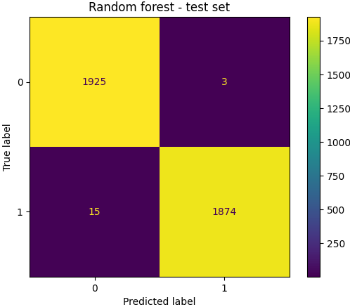
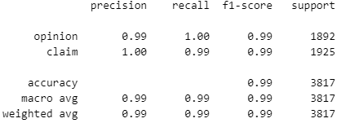
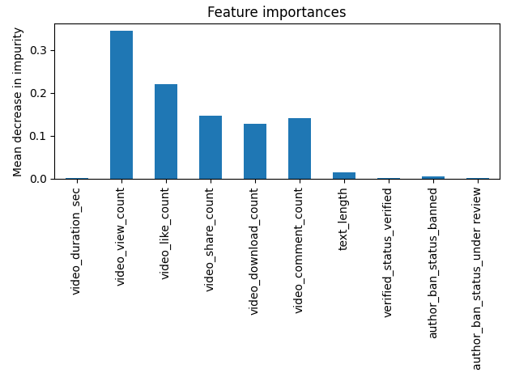
Random Forest Classification for TikTok Project
Executive summary report
Project Overview
The TikTok data team seeks to develop a machine learning model to assist in the classification of claims for user submissions. In this part of the project, the goal is to build a random forest classification model to predict whether a user submission on a video has a claim or an opinion. TikTok must review thoroughly user’s claims
The random forest model performed extremely well with training, validation and test data. It’s recall score is 0.99
We used recall measure to evaluate the model as we want to minimize false negatives which have a greater costs vs. false positives.
The model has great accuracy with only 18 false predictions on a test data set with 3817 observations.
We also built a XG Boost Model that performed slightly below the random forest model using validation data
User engagement level metrics on videos are best predictors on whether a submission is a claim or opinion. Video view count, video like count, video share count are the features that impact most on discerning between claims and opinions.
Upper-left: user opinions correctly predicted. Upper-right: the number of opinions incorrectly predicted. Lower-left: number of claims incorrectly predicted (false negatives). Lower-right: the number of claims correctly predicted.
Beta test the model in future TikTok user submissions. We expect the model to have very high prediction capability which would greatly reduced TikTok workload to review user submissions.
Furthermore, the data team recommends monitoring the distributions of video engagement levels to ensure that the model remains robust to fluctuations in its most predictive features.

